Slide 1
Operators
Fundamentals of Python Programming Chapter 3

Slide 2
Chapter Content
Arithmetic Operators
Comparison Operators
Logical Operators
Bitwise Operators
Assignment Operators
Identity Operators and Membership Operators

Slide 3
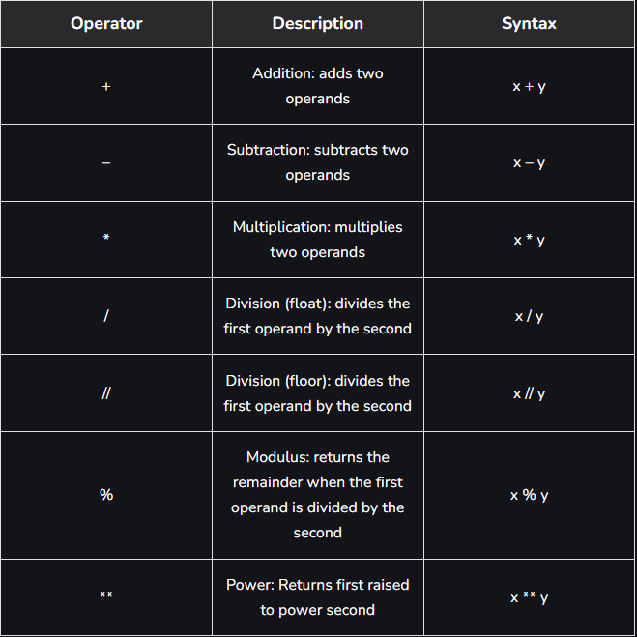
Arithmetic Operators
Python Arithmetic operators are used to perform basic mathematical operations like addition, subtraction, multiplication, and division.

Slide 4
Divison Types
Float division
The quotient returned by this operator is always a float number, no matter if two numbers are integers. For example:Example: The code performs division operations and prints the results. It demonstrates that both integer and floating-point divisions return accurate results. For example, ‘10/2' results in ‘5.0’, and ‘-10/2' results in ‘-5.0’.
Integer division( Floor division)
The quotient returned by this operator is dependent on the argument being passed. If any of the numbers is float, it returns output in float. It is also known as Floor division because, if any number is negative, then the output will be floored. For example:

Slide 5
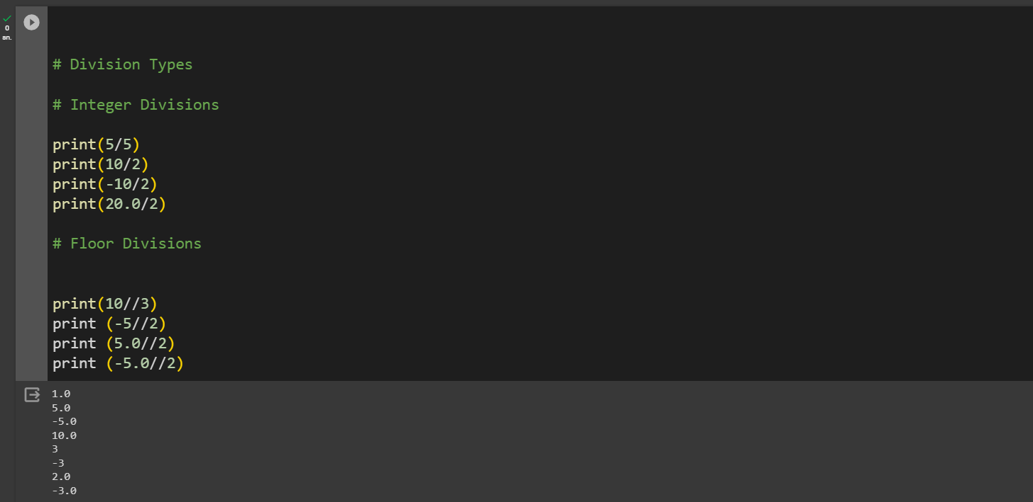
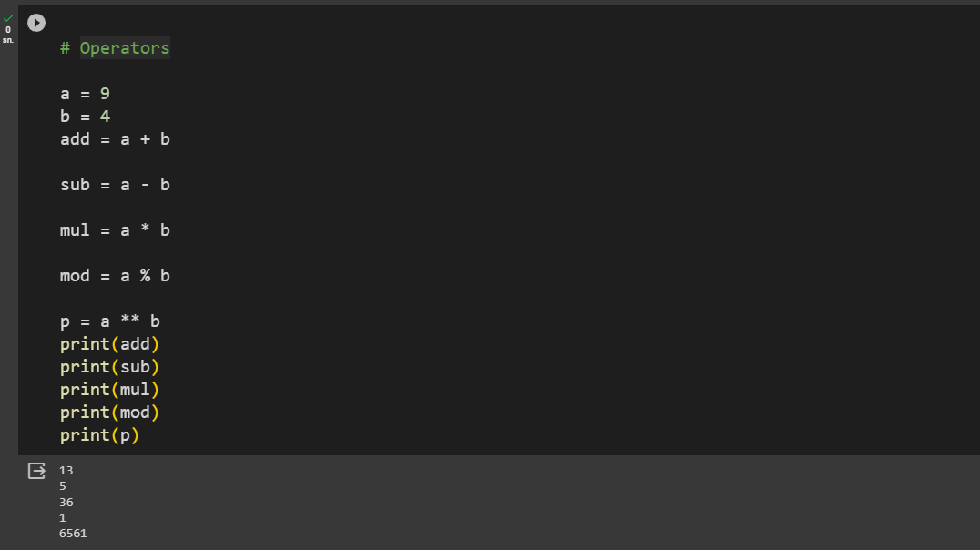
Arithmetic Operators in Code

Slide 6
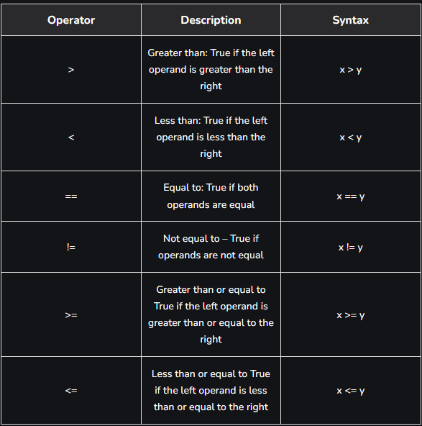
Comparison Operators
In Python Comparison of Relational operators compares the values. It either returns True or False according to the condition.

Slide 7
Precedence of Comparison Operators in Python
In python, the comparison operators have lower precedence than the arithmetic operators. All the operators within comparison operators have same precedence order.

Slide 8
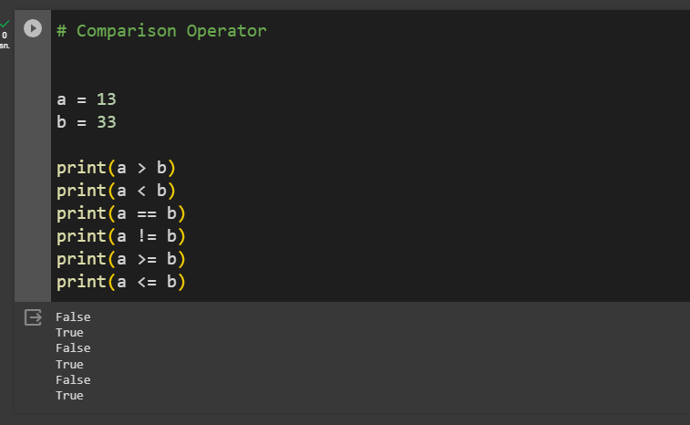
Comparison Operators in Code

Slide 9
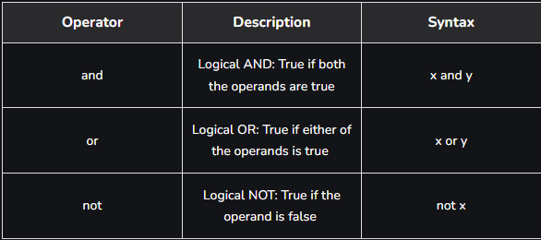
Logical Operators
Python Logical operators perform Logical AND, Logical OR, and Logical NOT operations. It is used to combine conditional statements.

Slide 10
Precedence of Logical Operators in Python
The precedence of Logical Operators in python is as follows:
Logical not
logical and
logical or

Slide 11
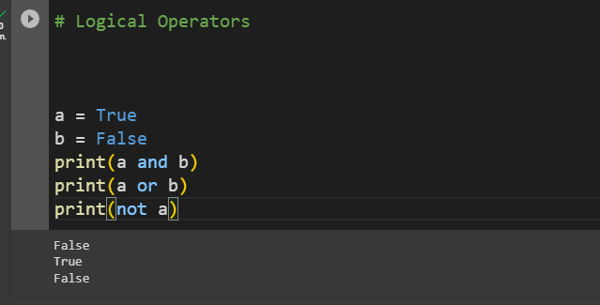
Logical Operators in Code

Slide 12
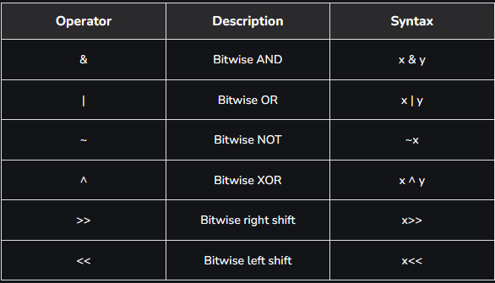
Bitwise Operators
Python Bitwise operators act on bits and perform bit-by-bit operations. These are used to operate on binary numbers.

Slide 13
Precedence of Bitwise Operators in Python
The precedence of Bitwise Operators in python is as follows:
Bitwise NOT
Bitwise Shift
Bitwise AND
Bitwise XOR
Bitwise OR

Slide 14
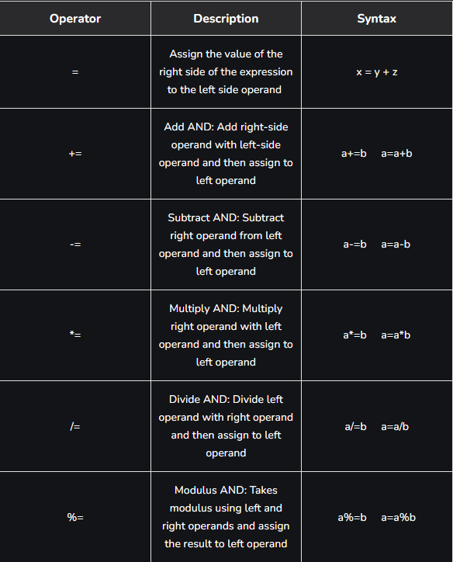
Assignment Operators
Python Assignment operators are used to assign values to the variables.

Slide 15
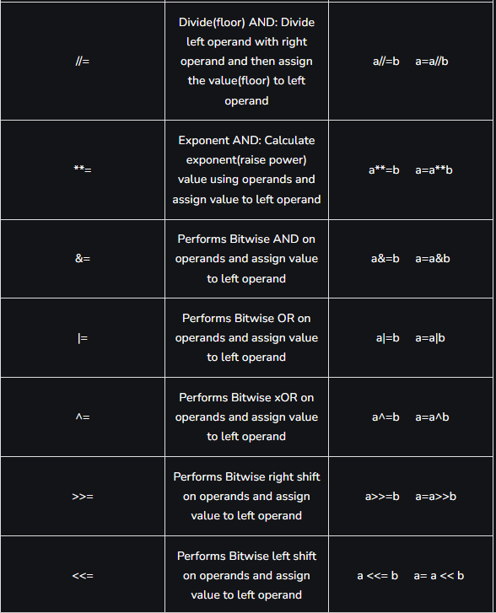
Assignment Operators
Python Assignment operators are used to assign values to the variables.

Slide 16
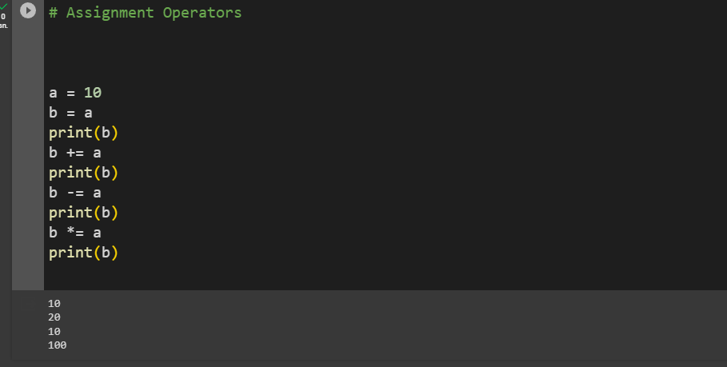
Assignment Operators in Code

Slide 17
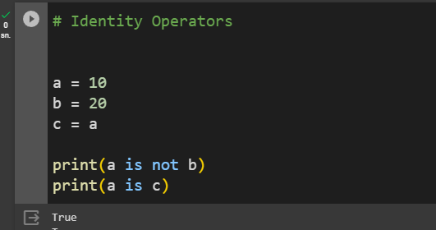
Identity Operators
In Python, is and is not are the identity operators both are used to check if two values are located on the same part of the memory. Two variables that are equal do not imply that they are identical.

Slide 18
Membership Operators
In Python, in and not in are the membership operators that are used to test whether a value or variable is in a sequence.

Slide 19
References
https://www.geeksforgeeks.org/python-programming-language/#python-operators

